Slide 1

Intelligent Placement and Career Development Platform
by
C. Vijaya Durga
Roll No. 214G1A32C1
V. Neeraja
Roll No. 214G1A3267
S. Vasim Subahani
Roll No. 214G1A32B7
A. Pavan Kumar
Roll No. 214G1A3272
Under the guidance of
Mr. K. Venkatesh, M. Tech., (Ph. D).
Assistant Professor
GitHub Link: https://github.com/k-venky/CSD_2021-25_B-17
Department of Computer Science and Engineering
Srinivasa Ramanujan Institute of Technology
(Affiliated to JNTUA & Approved by AICTE) (Accredited by NAAC with ‘A’ Grade & Accredited by NBA (EEE, ECE & CSE)
Rotarypuram Village, B K Samudram Mandal, Ananthapuramu – 515701.
2024 - 2025

Slide 2
Abstract
Colleges have to simplify their training and placement procedures due to the growth of institutions of higher learning and increased competition in the job market. Inefficient practices including manual student filtering, challenging data maintenance and lack of immediate interaction between students, professors and the Training and Placement Officer (TPO). Monitoring training progress, coordinating firm recruitment drives, tracking student eligibility and offering customized interview preparation materials are significant issues for educational institutions. Institutions suffer from unstructured resume screening, ineffective preparation for interviews and the inability to produce insights regarding student development. To overcome these challenges, we suggest a thorough, AI-powered Training and Placement Management System (TPMS) that is constructed with Django. It incorporates dashboards for teachers, students and TPOs to automate and quicken the placement process. By incorporating AI-based analytics and automation into training and recruitment processes this entire platform dramatically lowers manual load, increases placement efficiency and improves student employability.
Keywords: Academic Year, Eligibility, Faculty, Placement, Student, Training and User Management.

Slide 3

Contents
Introduction
Literature Survey
Existing System
Proposed System
Objectives
Requirements (functional and nonfunctional)
System Architecture
Data Flow Diagram / UML / ER
Implementation
Sample Code
Results (Screenshots)
Conclusion
References
Paper submission proof
3

Slide 4
Introduction
The increasing competition in the job market has highlighted the importance of equipping students with the skills and knowledge required to meet the expectations of recruiters and excel in placement processes.
Educational institutions often face challenges in effectively managing placement statistics, monitoring student progress and providing tailored resources to enhance career readiness.
Traditional approaches to career development and placement management are limited in their ability to provide actionable insights, personalized recommendations and efficient support for both students and recruiters.
Students frequently encounter difficulties in aligning their resumes and skillsets with the requirements of hiring companies, while recruiters struggle to identify suitable candidates efficiently.

Slide 5
Literature Survey
No | Title | Author | Journal Name & Year | Methodology Adapted | Key Findings | Gaps
1 | Smart Preparation Web Application for Placements Using Machine Learning | Prasanna Kandekar, Manjiri Raut | International Research Journal of Engineering and Technology (IRJET) & 2024 | Uses AI/ML models, and Node.js with MongoDB for data and feedback. | Helps students prepare better with accurate predictions and tailored learning. | Needs improved privacy, personalization, and testing.
2 | Enhancing Student Placement with Cross-Platform Application | Anand Kale, Shreyas Joshi et al. | International Journal for Research in Applied Science & Engineering Technology & 2024 | React Native and Spring Boot for backend | Efficient data management, document verification, and modular user roles | Limited focus on AI-enhanced analytics and scalability for large datasets
3 | C3-IoC: A Career Guidance System for Assessing Student Skills using Machine Learning and Network Visualisation | Adán José-García, Alison Sneyd et al. | International Journal of Artificial Intelligence in Education & 2024 | AI-based solution with similarity metrics and skill profiling | Career guidance through job role matching and visual networks | Limited adaptation to non-IT sectors and dynamic market trends

Slide 6
Cont’d…
No | Title | Author | Journal Name & Year | Methodology Adapted | Key Findings | Gaps
4 | Enhancing Student Placement Preparation Through Web Application | P Shanmugam, Janhavi Lenka et al. | International Conference on Innovative Computing & Communication & 2024 | Comprehensive platform with personalized learning and mentorship. | Tailored resources, student progress tracking, and collaboration among stakeholders. | Lack of AI-driven analytics and industry-specific real-time recommendations.
5 | An Integrated Web Application for Training and Placement | Dr. Gauri Dhopavkar et al. | Mathematical Statistician and Engineering Applications & 2022 | Development of a Training & Placement Portal System using automation. | Automated tasks improve precision, save time, and provide students with notifications, question banks, and company details. | Lack of advanced analytics for personalized student-company matching and integration of AI.
6 | Design and Development of Department Placement Portal using MERN Technology | Fiza Kousar et al. | International Advanced Research Journal in Science, Engineering and Technology & 2022 | MVC architecture using MERN stack for web portal development. | Simplifies placement tasks with modules for student credentials, job postings, and placement statistics. | Limited focus on advanced analytics or AI for enhancing student-company matching efficiency.

Slide 7
Existing System
All processes in existing system are handled manually. All the work that is done in the existing system is done by the human intervention .As all the work is done manually, there were a lot of workload on placement officer and it also increases the maximum chances of errors.
This is so slow and time consuming. Due to increase in number of user’s the process become more difficult. Problems faced in existing system are as follows
Searching of eligible students is done manually by TPO based on the company criteria.
The records were stored in modified excel sheets hence sorting problem.

Slide 8
Cont’d…
The duplication of records was usual hence data redundancy.
TPO’s have to collect all the information and Resumes of students and organize them manually and sort them according to various streams.
Collecting CV’s of so many student is a painful and time consuming task and handling of too many CV’s is a great overhead.
It takes too much time to managing, updating and informing specific student for specific company criteria.

Slide 9
Proposed System
Placement Statistics Management: The system provides real-time insights into placement statistics, including the number of students placed, job roles and company-wise data.
Student Performance Tracking: A performance tracking module monitors students' progress in training programs, offering detailed feedback and analytics to help students identify areas for improvement.
NLP-Driven Resume Scanning: Utilizing NLP techniques, the system evaluates resumes, assigns scores based on relevance and quality, and suggests improvements to align with industry requirements.
Recruitment Process Information: The platform provides a comprehensive database of company profiles and recruitment processes, helping students understand the expectations of recruiters.
Personalized Learning Recommendations: A recommendation engine powered by sentiment analysis and machine learning suggests training videos and resources tailored to individual students' learning styles.

Slide 10
Objectives
Automate Placement Management – Streamline the placement process by providing a centralized system for tracking student progress, managing placement records, and organizing recruitment activities.
Enhance Student Career Readiness – Improve student employability by offering NLP-based resume evaluation, personalized training recommendations, and real-time placement updates.
Support the Training & Placement Officer (TPO) – Provide a dashboard for the TPO to monitor student training progress, placement statistics, and recruitment activities efficiently.
10

Slide 11
Requirements : Functional Requirements
NLP-Driven Resume Scanner
Placement Process Tracking
Company Profile Management
Training Program Tracking and Feedback
Personalized Training Video Recommendations
11

Slide 12
Requirements : Non-Functional Requirements
Scalability
System Performance and Speed
User Interface Usability
Data Integrity
Cross-Platform Compatibility
Reliability and Availability
System Maintainability and Security
12

Slide 13
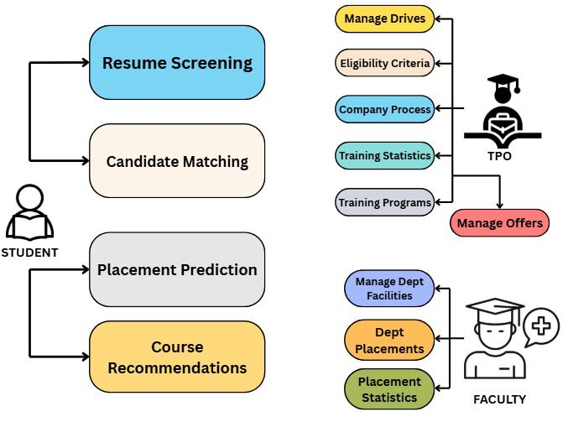
System Architecture
Campus Placement Management System
13

Slide 14
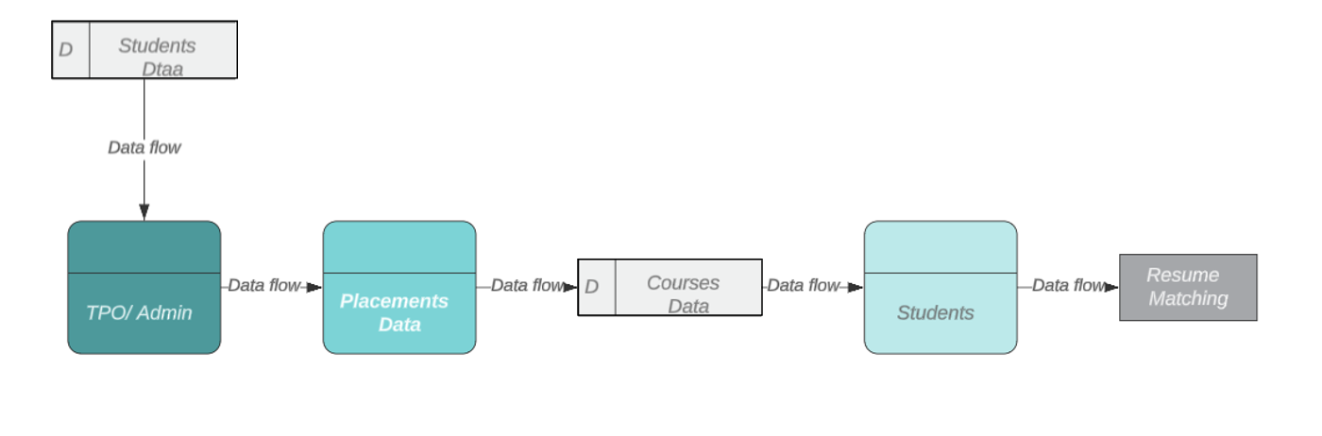
Data Flow Diagram
Student Placement Data Flow Diagram

Slide 15
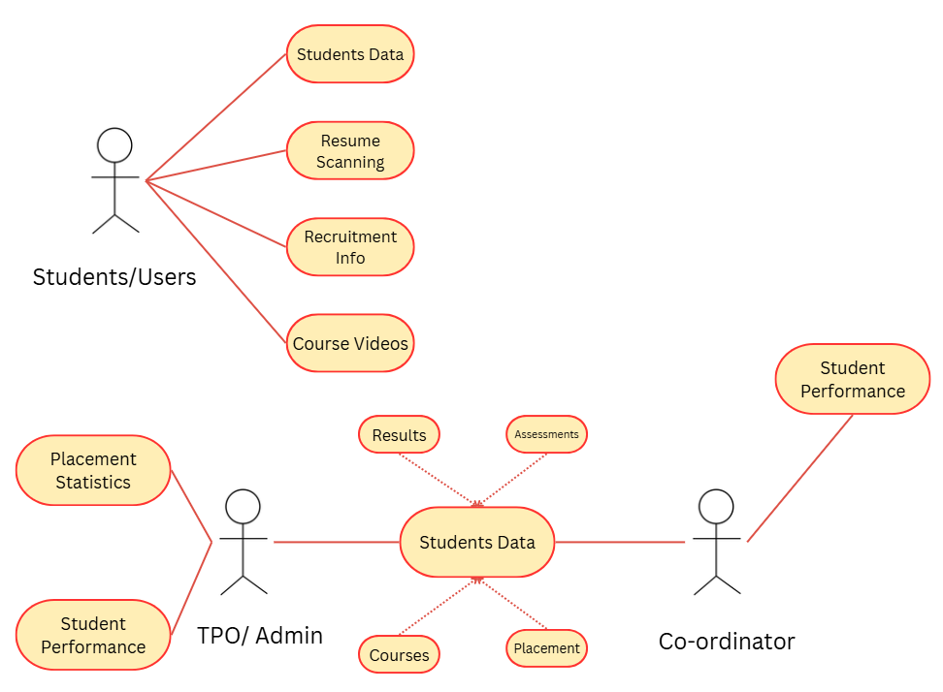
UML Diagrams – Use Case Diagram
Use Case Diagram

Slide 16
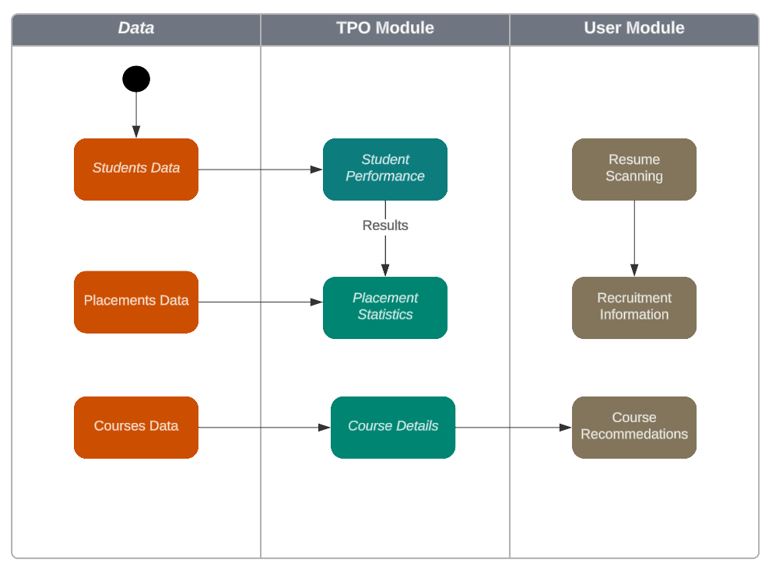
UML Diagrams- Activity Diagram
Activity Diagram
16

Slide 17
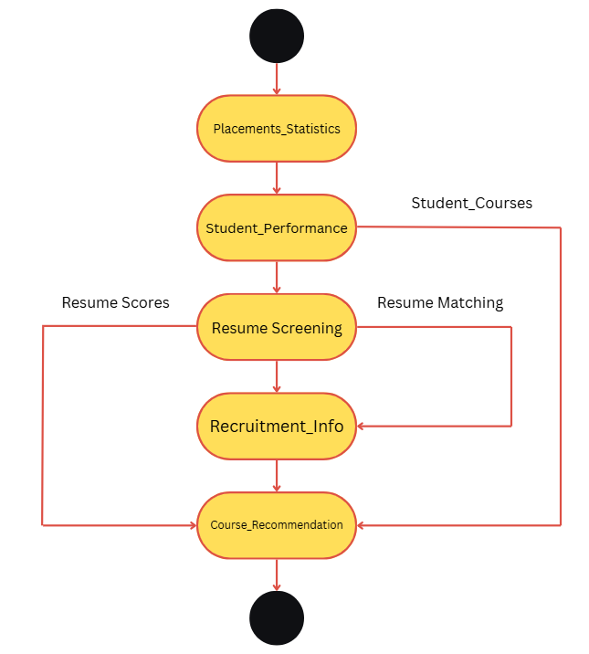
UML Diagrams- Statechart Diagram
Statechart Diagram

Slide 18
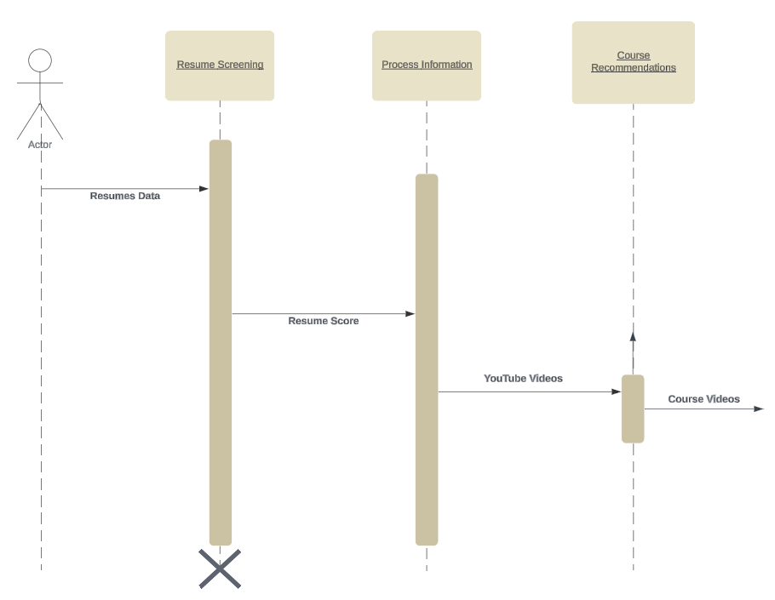
UML Diagrams- Sequence Diagram
Sequence Diagram
18

Slide 19
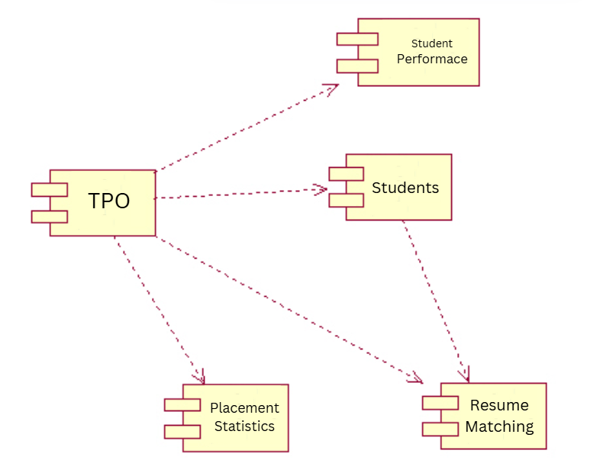
UML Diagrams- Component Diagram
Component Diagram

Slide 20
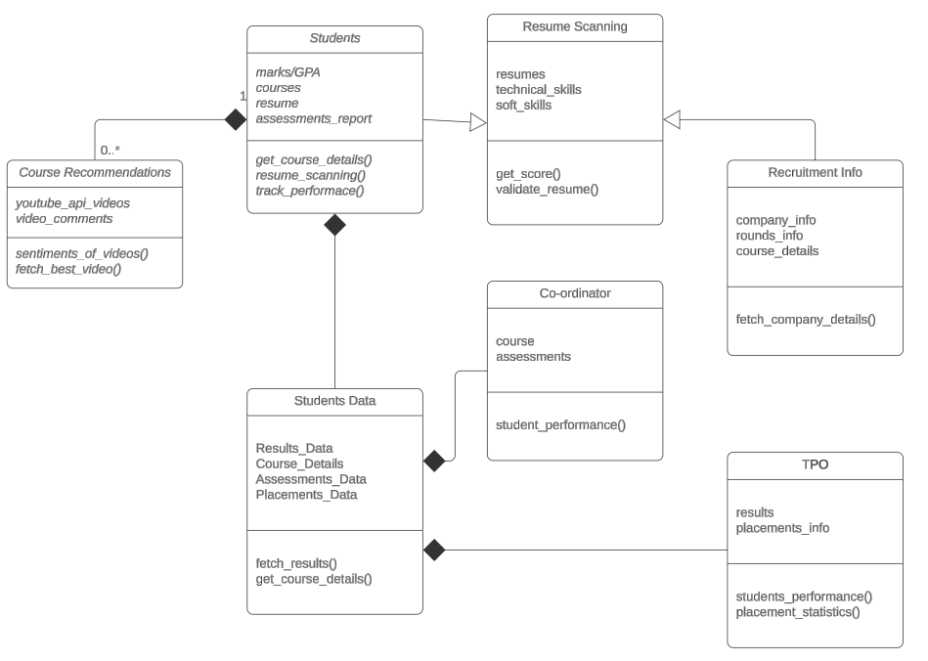
UML Diagrams- Class Diagram
Class Diagram

Slide 21
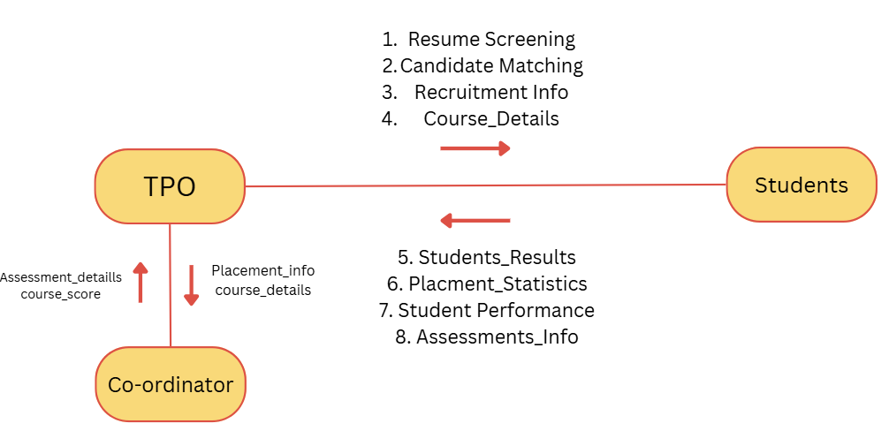
UML Diagrams- Collaboration Diagram
Collaboration Diagram

Slide 22
Implementation
NLP-Driven Resume Scanner: Analyzes student resumes, scores them, and provides suggestions for improvement based on recruiter requirements.
Company Profile Management: Administers the addition and updating of company profiles, including job descriptions and eligibility criteria.
Training Program Tracking: Monitors student participation and performance in training programs, offering feedback to enhance skill development.
Sentiment-Based Recommendation Engine: Uses sentiment analysis to recommend personalized learning resources like training videos based on students' emotional responses.
Placement Process Tracker: Tracks ongoing and past placement processes, providing status updates and notifications to students.
22

Slide 23
NLP-Driven Resume Scanner
The NLP-Driven Resume Scanner evaluates student resumes using NLP techniques to analyze content, structure, and relevance to recruiter expectations.
It assigns a score based on skills, experience, and keyword matching while providing personalized improvement suggestions to enhance resume quality and alignment with job roles.
This automated system streamlines the screening process, ensuring better visibility and higher chances of selection for candidates.

Slide 24
Company Profile Management
The Company Profile Management System provides a centralized platform for storing and managing company details, job openings, and hiring processes.
It includes company information, recruitment rounds (online test, technical interview, HR interview, etc.), eligibility criteria, required skills, and salary packages.
This system helps students and job seekers access structured company insights, preparing them effectively for placements while enabling recruiters to streamline candidate evaluation and selection.

Slide 25
Sentiment-Based Recommendation Engine
The Sentiment-Based Recommendation Engine leverages sentiment analysis to assess students' emotional responses and recommend personalized learning resources.
By analyzing text inputs (feedback, queries, or reviews), it determines sentiment (positive, neutral, or negative) and suggests relevant training videos using the YouTube API.
This system enhances learning engagement by tailoring recommendations to students' moods and preferences, ensuring a more effective and adaptive learning experience.

Slide 26
Placement Process Tracker
The Placement Process Tracker monitors ongoing and past placement processes, offering real-time status updates, company details, recruitment rounds, and results.
It helps students stay informed about shortlisting, interview schedules, and final selections, ensuring better preparation and tracking of their job applications.
This system streamlines the placement experience, providing a structured overview of opportunities and outcomes.

Slide 27
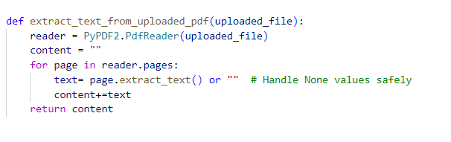
Sample Code
Extraction of Text from Resume

Slide 28
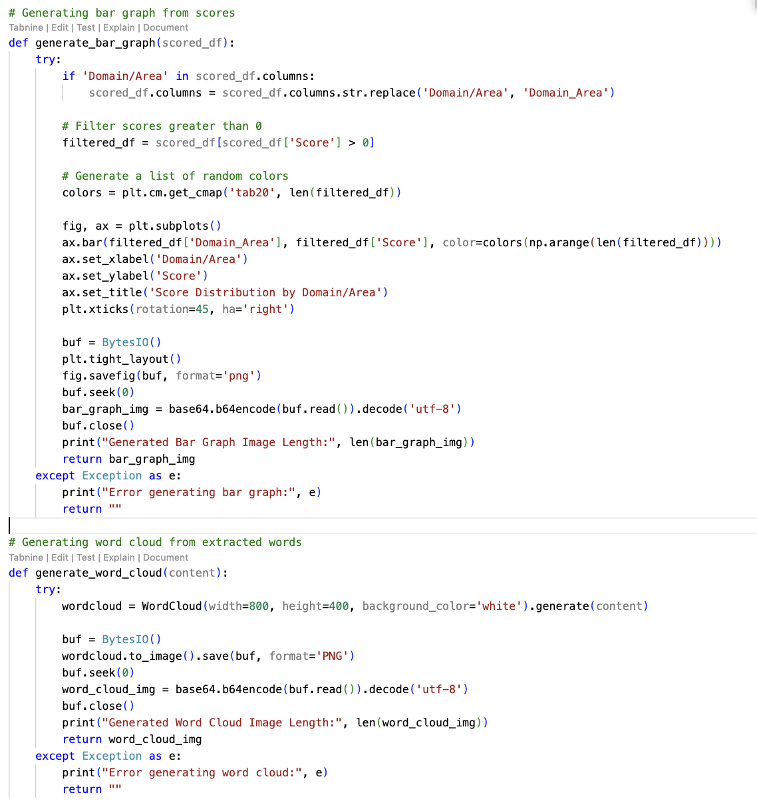
Cont’d…
Bar Graph and Word Cloud

Slide 29
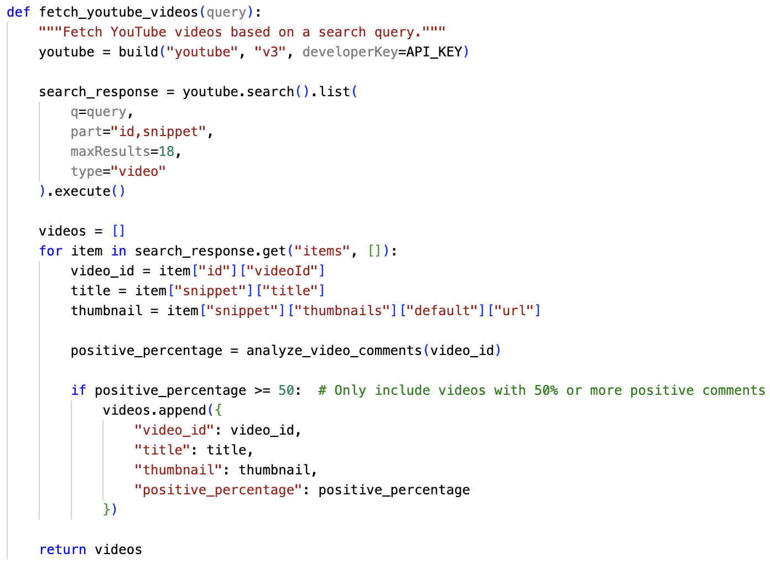
Cont’d…
Fetching Videos

Slide 30
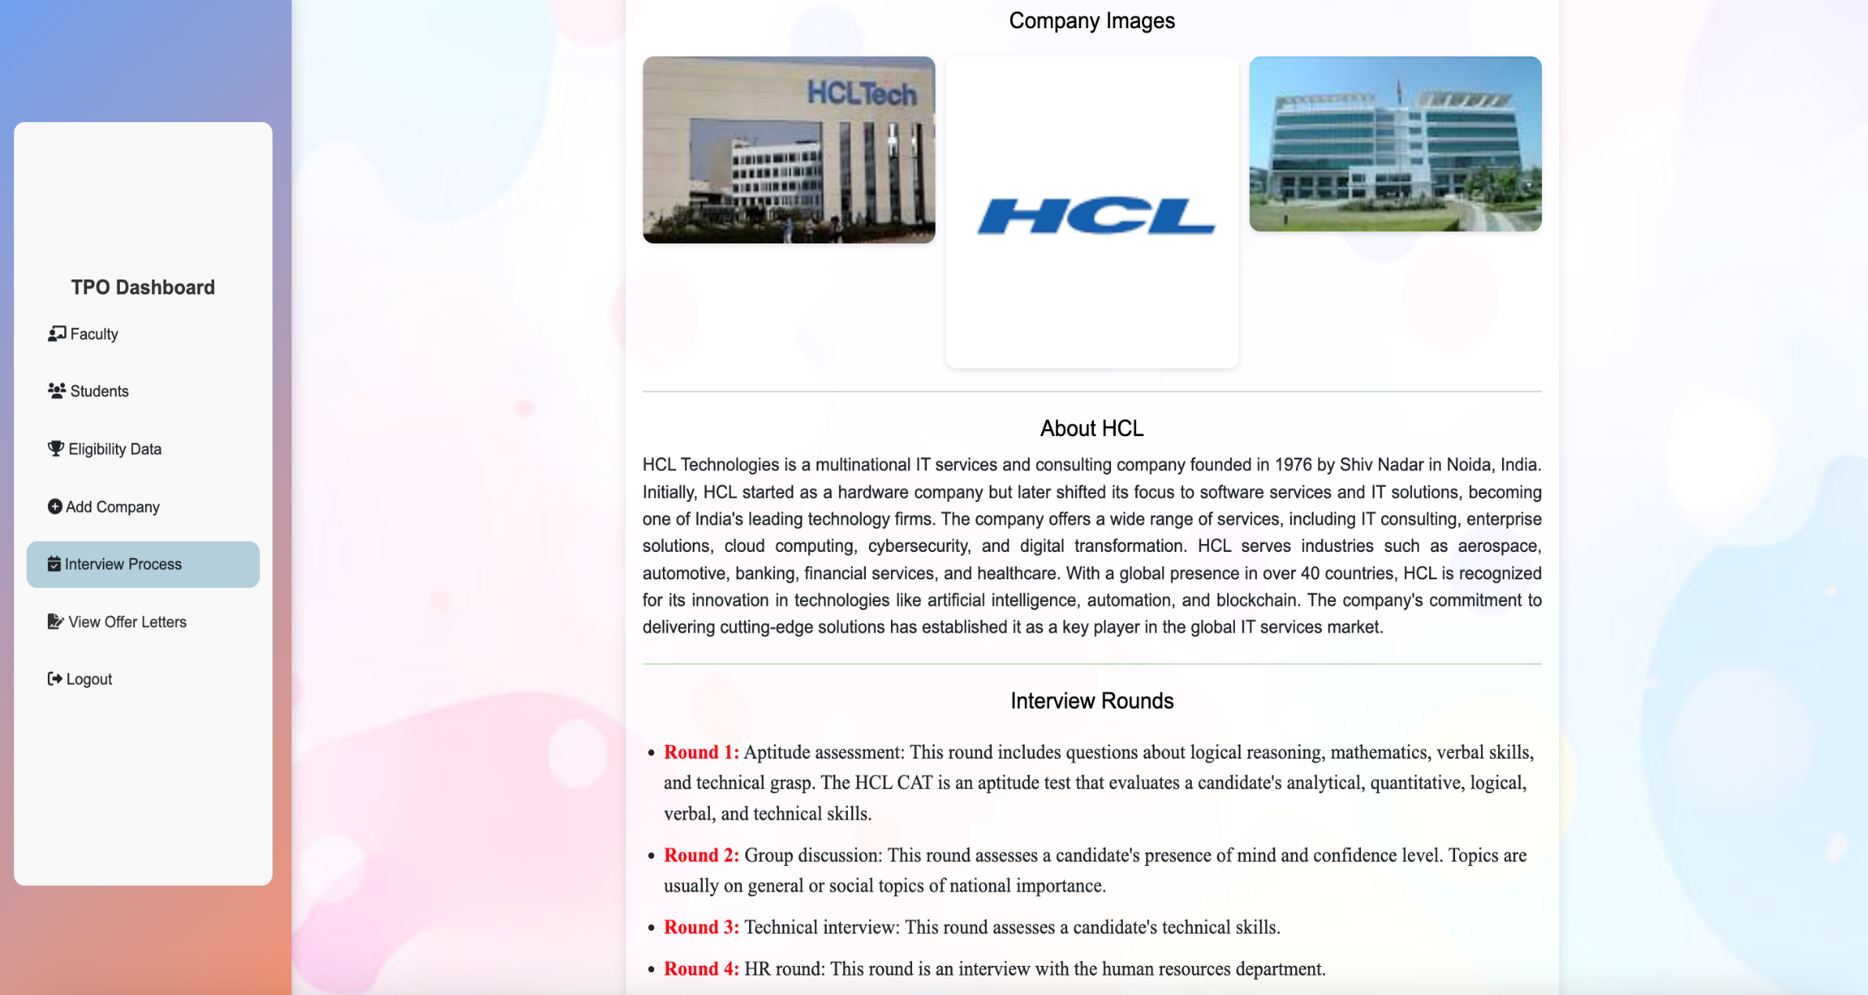
(Results (Screenshots) - Company Process

Slide 31
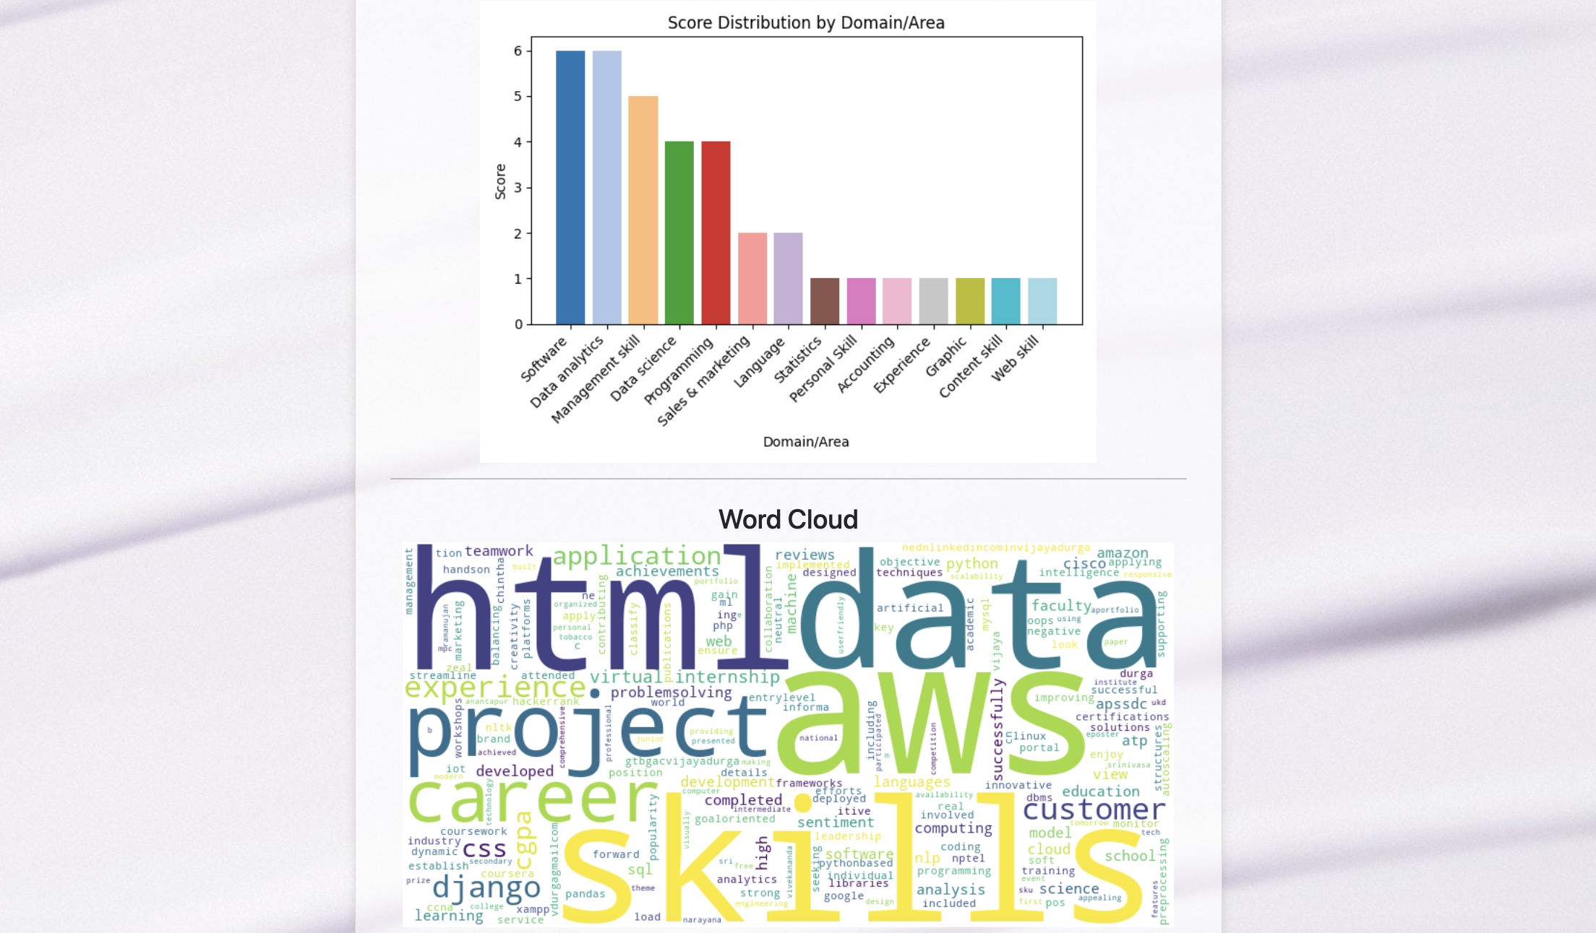
NLP – Resume Scanner

Slide 32
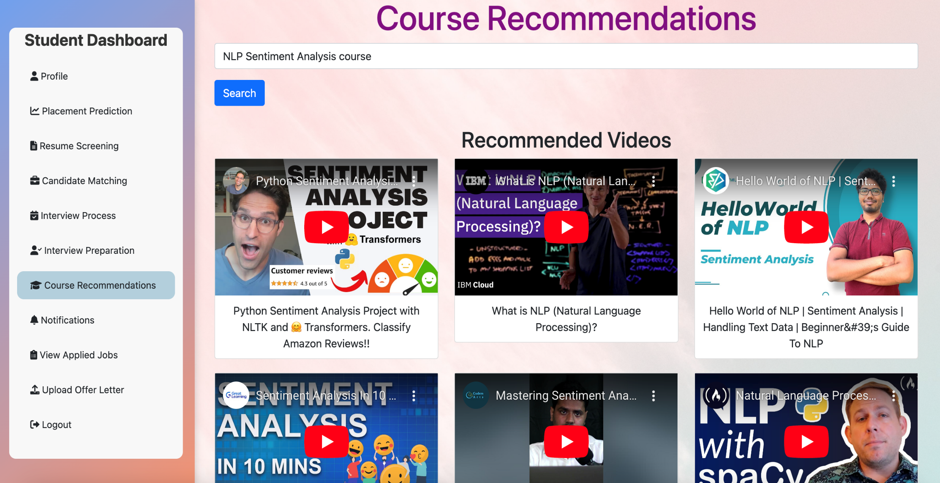
Course Recommendations

Slide 33
Conclusion
The successful implementation of this project demonstrates its effectiveness in overcoming challenges using Python, Django, and machine learning libraries.
Through systematic analysis, design, implementation, and testing, the system has been fine-tuned to achieve its objectives, providing improved accuracy, faster processing, and a seamless user experience.
The results demonstrate that AI-driven approaches enhance efficiency, decision-making, and accuracy while reducing computational complexity.
Overall, this project serves as a strong foundation for further research and development, demonstrating the potential of intelligent automation and AI-powered solutions in addressing complex challenges.

Slide 34
References
Prasanna Kandekar, Manjiri Raut, "Smart Preparation Web Application for Placements Using Machine Learning" International Research Journal of Engineering and Technology (IRJET), Volume: 11, Issue: 03, Mar 2024
Kale, Anand, et al. "Enhancing Student Placement with Cross-Platform Application.“
José-García, Adán, et al. "C3-IoC: A career guidance system for assessing student skills using machine learning and network visualisation." International Journal of Artificial Intelligence in Education 33.4 (2023): 1092-1119.
Shanmugam, P., Janhavi Lenka, and M. Yousuf Suhail. "Enhancing Student Placement Preparation Through Web Application." Available at SSRN 4834698 (2024).
Dr. Gauri Dhopavkar, Toshit Kale,"An Integrated Web Application for Training and Placement" Mathematical Statistician and Engineering Applications & 2022, Vol. 71 No. 4 (2022).
Fiza Kousar1, Gandharva V Hegde, "Design and Development of Department Placement Portal using MERN Technology.” International Advanced Research Journal in Science, Engineering and Technology & 2022, Vol. 9, Issue 1, January 2022.

Slide 35
Any Queries?

Slide 36
Thank You!!!

